Slide 1



7th NATIONAL SYMPOSIUM ON ROTOR DYNAMICS 2024
FAULT CLASSIFICATION IN ROLLING ELEMENT BEARINGS USING MACHINE LEARNING TECHNIQUES
Mirza Samad Beg,
Ravuri Yuvanth,
Prabhu S,
C. Shravankumar
SRMIST, Kattankulathur, India

Slide 2
OVERVIEW
Introduction
Methodology
Description of the work
Result and discussion
Conclusion
7th NSRD 2024

Slide 3
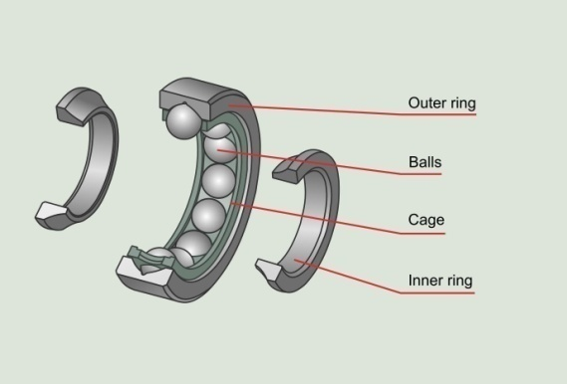
Introduction
Problem Statement:
The reliability of rolling element bearings in machinery is critical for reducing downtime and maintenance costs. Fault detection in bearings is a challenge due to the complex behavior of vibrations over time.
Significance of the Problem:
Bearings are essential components in rotating machinery, and faults can lead to costly breakdowns.
Early detection of bearing faults ensures better predictive maintenance, minimizes unplanned downtimes, and prolongs equipment lifespan.
Applications:
Manufacturing and industrial automation
Aerospace and automotive industries
Energy and heavy machinery sectors
Objectives of the Work:
Apply machine learning techniques to classify fault types in rolling element bearings.
Extract and analyze time-domain and frequency-domain features from vibration signals.
Investigate different machine learning models for fault diagnosis and predictive maintenance strategies.
7th NSRD 2024

Slide 4
Introduction
Fault Type | Description | Frequency Name | Formula | Calculated Value
Inner Race Fault | Damage or defect on the inner race of the bearing, where the rolling elements interact with the inner surface. | BPFI (Ball Pass Frequency Inner): Represents the frequency at which rolling elements pass a specific point on the inner race. This frequency increases with defects on the inner race. | BPFI = | 296.90 Hz
Outer Race Fault | Damage or defect on the outer race, the outer surface of the bearing that supports the rolling elements. | BPFO (Ball Pass Frequency Outer): Indicates the frequency at which rolling elements pass a specific point on the outer race. A defect in the outer race produces vibrations at this frequency. | BPFO = | 236.43 Hz
Roller Element Fault | Defects such as spalls or cracks on the rolling elements (balls), which roll between the inner and outer races. | BSF (Ball Spin Frequency): Refers to the spin frequency of the rolling elements (balls) themselves. Faults in the balls (e.g., cracks or spalls) cause vibrations at this frequency. | BSF = | 140.04 Hz
n: Number of rolling elements, d: Diameter of rolling elements, D: Pitch diameter, θ: Contact angle, fr​: Shaft rotational frequency
7th NSRD 2024

Slide 5
Methodology
Schematic representation of the work.
Data Collection
IMS Bearing Dataset
Vibration signals at 20 kHz
Feature Extraction
Time-Domain Features: Mean, RMS, Kurtosis, Skewness, Crest Factor, etc.
Frequency-Domain Features: Peak frequency, amplitude via FFT
Performance Evaluation
Metrics: Accuracy, Precision, Recall, F1 Score, Confusion Matrix
Model Selection and Training
Random Forest, Decision Tree, XGBoost, SVM, ANN, Logistic Regression, KNN
Hyperparameter tuning
Data Preprocessing
Normalization
Splitting into training and testing sets
7th NSRD 2024

Slide 6
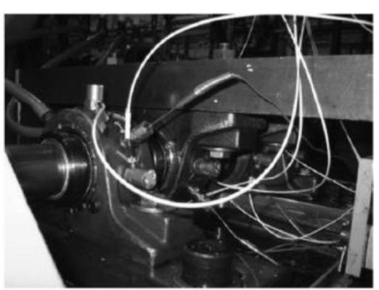
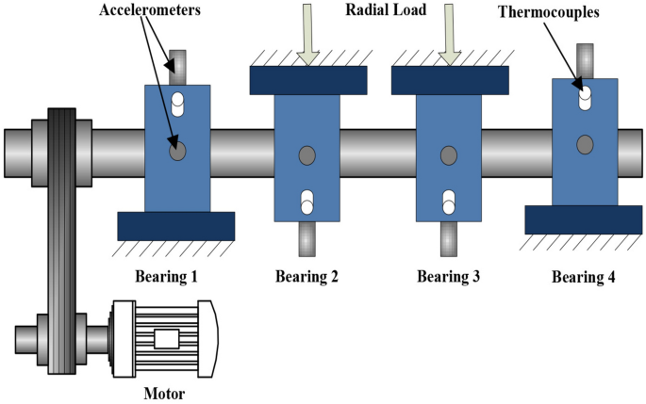
Description of the work
Experimental Setup:
Test Rig Setup:
Four Rexnord ZA-2115 double-row bearings mounted on a shaft.
Shaft driven by an AC motor at a constant speed of 2000 RPM.
Radial load of 6000 lbs applied via a spring mechanism.
Instrumentation:
PCB 353B33 High Sensitivity Quartz ICP Accelerometers mounted on the bearing housing.
Sensor arrangement:
Dataset 1: Two accelerometers (x- and y-axes) per bearing.
Datasets 2 & 3: One accelerometer per bearing.
Data Collection Details:
Three datasets describing test-to-failure experiments:
Dataset 1: Inner race and roller element defects.
Dataset 2: Outer race defect (Bearing 1).
Dataset 3: Outer race defect (Bearing 3).
Recording intervals: 10 minutes (5 minutes for initial 43 files in Dataset 1).
Failure Progression:
Faults occurred after bearings exceeded their design life of 100 million revolutions.
7th NSRD 2024

Slide 7
Description of the work
Dataset Overview: IMS Bearing Dataset
Source:
The dataset is provided by the NSF I/UCR Center for Intelligent Maintenance Systems (IMS).
It contains vibration data collected from bearings under varying operating conditions.
Dataset Details:
Vibration signals collected using accelerometers placed on the bearings.
Sampling frequency: 20 kHz.
Total data points per file: 20,480 points.
Key Features:
Covers three primary types of faults: Inner race defects, outer race defects, and roller element defects.
Includes healthy bearing data for baseline comparison.
Objective:
Analyze vibration signals to detect and classify bearing faults.
7th NSRD 2024

Slide 8
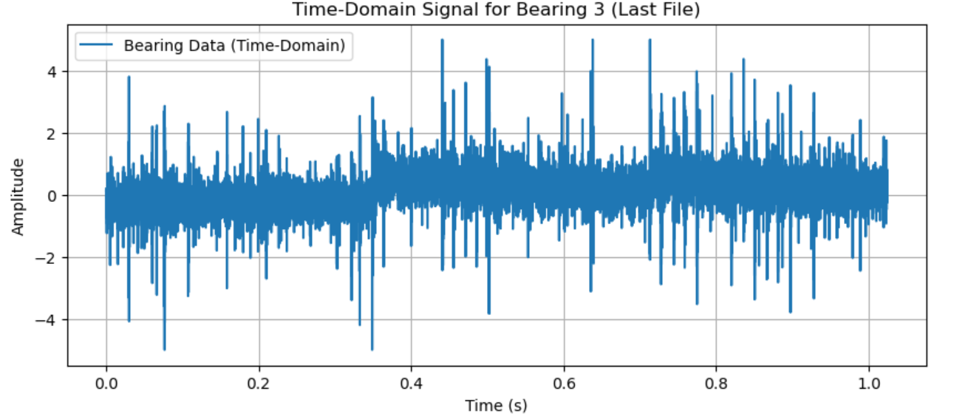
Description of the work
Feature Engineering for Fault Diagnosis:
Objective of Feature Extraction:
Transform raw vibration signals into meaningful metrics for machine learning models.
Capture both time-domain and frequency-domain characteristics.
Time-Domain Features:
Maximum, Minimum, Mean, Standard Deviation (Std): Basic statistical metrics.
RMS (Root Mean Square): Signal power indicator.
Skewness: Asymmetry of the signal distribution.
Kurtosis: Sharpness or flatness of the signal peak.
Crest Factor: Ratio of signal peak to RMS.
Form Factor: Ratio of RMS to mean value.
7th NSRD 2024

Slide 9
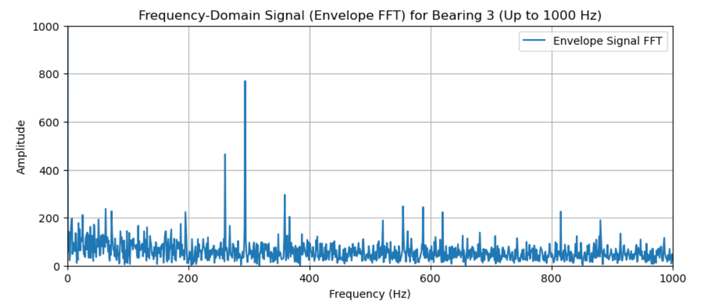
Description of the work
Frequency-Domain Features:
FFT (Fast Fourier Transform): Frequency analysis of the vibration signal.
Envelope Detection: Highlight modulated frequencies indicating defects.
Top 5 Peak Frequencies and Amplitudes: Key indicators of fault type and severity.
Additional Feature
Revolutions:
Added the number of shaft revolutions since the start of the experiment as a feature.
Calculated using the time index of each vibration snapshot:
Revolutions = Elapsed Time (s)×Rotational Speed (RPS)
7th NSRD 2024

Slide 10
Description of the work
Table of Extracted Features:
Index | Max | Min | Mean | Std | RMS | Skewness | Kurtosis | Crest Factor | Form Factor | Peak Frequency 1 | Peak Frequency 2 | Amplitude1 | Amplitude 2 | Revolutions | state
1 | 0.4 | -0.496 | -0.09081 | 0.091463 | 0.128887 | 0.0343691 | 0.405106 | 3.103493 | -1.419275 | 493.16406 | 14.64844 | 90.59393 | 42.0558421 | 33 | Initial
2 | 0.493 | -0.566 | -0.0915 | 0.091734 | 0.129562 | 0.0010971 | 0.445381 | 3.805125 | -1.416038 | 493.16406 | 33.20313 | 100.8939 | 40.6184416 | 20033 | Initial
3 | 0.386 | -0.601 | -0.09392 | 0.091815 | 0.131339 | 0.0530678 | 0.389381 | 2.938962 | -1.398465 | 493.16406 | 14.64844 | 97.64808 | 49.8327765 | 40033 | Initial
1049 | 0.574 | -0.833 | -0.11453 | 0.111536 | 0.159864 | 0.0011053 | 0.795298 | 3.590547 | -1.395842 | 36.132813 | 33.20313 | 51.0929 | 47.596381 | 20940033 | Middle
1050 | 0.476 | -0.725 | -0.11459 | 0.112921 | 0.160878 | 0.0026802 | 0.758125 | 2.958758 | -1.403927 | 494.14063 | 1.953125 | 55.14934 | 54.3997314 | 20960033 | Middle
1051 | 0.686 | -0.801 | -0.11423 | 0.113336 | 0.160912 | -0.00525 | 0.807285 | 4.263196 | -1.408684 | 14.648438 | 494.1406 | 82.7756 | 55.7539361 | 20980033 | Middle
2155 | 4.902 | -5 | -0.10755 | 0.520587 | 0.531569 | -0.083691 | 11.26935 | 9.221756 | -4.942327 | 293.94531 | 359.375 | 484.43 | 378.936505 | 43060033 | Inner race
2156 | 4.316 | -4.875 | -0.11718 | 0.459761 | 0.474447 | -0.303903 | 9.387377 | 9.096908 | -4.048985 | 293.94531 | 359.375 | 453.9675 | 366.928725 | 43080033 | Inner race
2157 | 4.998 | -5 | 0.129027 | 0.579432 | 0.59361 | 0.0671893 | 5.901806 | 8.419671 | 4.600673 | 293.94531 | 260.7422 | 770.1537 | 464.321311 | 43100033 | Inner race
In actual dataset Top 5 Peak Frequencies and Amplitudes were used (This table indicated extracted features of bearing 3 in test 1).
7th NSRD 2024

Slide 11
Description of the work
Model Selection and Evaluation :
Objective:
Use extracted features to train and evaluate machine learning models for fault classification.
Models Used:
Random Forest (RF): High accuracy and interpretability.
Decision Tree (DT): Simple and effective for classification.
XGBoost (XGB): Gradient boosting for robust performance.
Support Vector Machine (SVM): Effective for high-dimensional data.
Artificial Neural Network (ANN): Captures complex patterns in the data.
K-Nearest Neighbors (KNN): Distance-based classification.
Logistic Regression (LR): Baseline model for comparison.
Key HyperParameters:
RF: n_estimators = 100, max_depth = 25, max_features=​sqrt
DT: max_depth = 8, Pruning Parameter (α = 0), max_features = 20
SVM: Regularization Parameter (C = 100), Decision Boundary Parameter (γ = 0.1)
ANN: Number of Hidden Layers = 1, Hidden Layer Size = 50, Learning Rate = 0.01, Epochs = 1000.
KNN: metric = euclidean, n_neighbors = 1, Weights = Uniform.
LR: Regularization Strength (C = 10), Penalty = L2, Solver = lbfgs
XGB: max_depth = 9, n_estimators = 50, learning_rate = 0.1, subsample = 1.0.
7th NSRD 2024

Slide 12
Result and discussion
Performance Analysis:
Model Performance:
Best Model: Random Forest achieved the highest accuracy (>99%) with minimal misclassification.
Other High-Performing Models: Decision Tree and XGBoost also performed well, showcasing robust classification ability.
Worst Model: KNN, with an accuracy of 95.11%, struggled due to overlapping class features.
Model | Accuracy (%)
Random Forest (RF) | 99.83
Decision Tree (DT) | 99.68
XGBoost (XGB) | 99.44
Support Vector Machine (SVM) | 98.54
Artificial Neural Network (ANN) | 96.30
Logistic Regression (LR) | 96.24
K-Nearest Neighbors (KNN) | 95.11
7th NSRD 2024

Slide 13
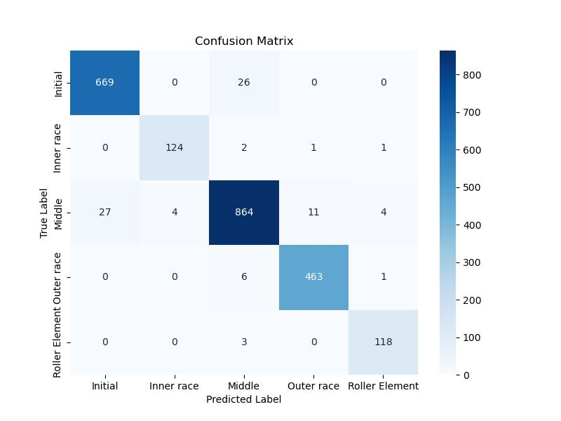
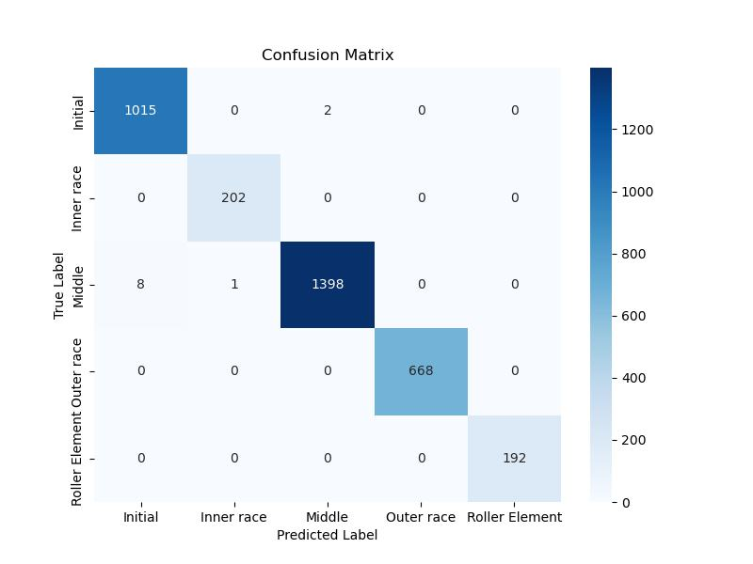
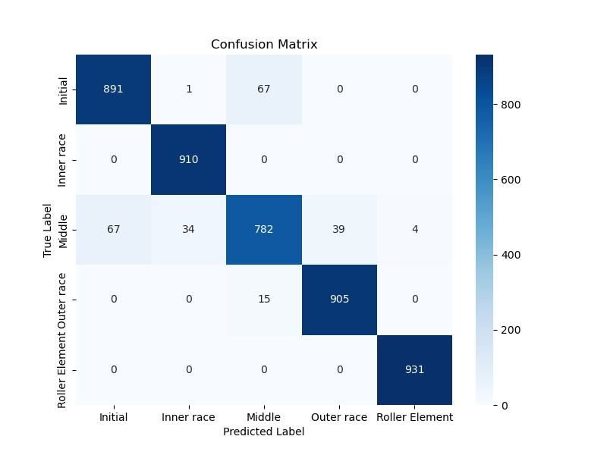



Result and discussion
Confusion Matrix for the models:
ANN DT KNN
LR RF XGB
7th NSRD 2024

Slide 14
Result and discussion
Class-Specific Metrics:
Precision: RF and XGB achieved perfect precision for most classes, ensuring minimal false positives.
Recall: RF demonstrated perfect recall for all fault types, meaning no faults were missed.
F1 Score: RF and DT excelled with near-perfect scores across all classes.
KNN struggled with the "Worn Out" class (C3), showing lower recall and F1 scores due to overlapping class features.
Metrics |  | ML Model
 |  | ANN | DT | KNN | LR | RF | SVM | XGB
Accuracy |  | 96.30 | 99.68 | 95.11 | 96.24 | 99.83 | 98.54 | 99.44
Precision | C1 | 0.96 | 0.99 | 0.93 | 0.94 | 1.00 | 0.98 | 1.00
 | C2 | 0.97 | 1.00 | 0.96 | 0.94 | 1.00 | 0.99 | 1.00
 | C3 | 0.96 | 1.00 | 0.91 | 0.96 | 1.00 | 0.96 | 0.99
 | C4 | 0.97 | 1.00 | 0.96 | 0.99 | 1.00 | 0.99 | 0.99
 | C5 | 0.95 | 1.00 | 1.00 | 0.98 | 1.00 | 1.00 | 1.00
Recall | C1 | 0.96 | 1.00 | 0.93 | 0.97 | 1.00 | 0.97 | 1.00
 | C2 | 0.97 | 1.00 | 1.00 | 0.99 | 1.00 | 1.00 | 0.99
 | C3 | 0.95 | 0.99 | 0.84 | 0.94 | 1.00 | 0.96 | 1.00
 | C4 | 0.99 | 1.00 | 0.98 | 0.99 | 1.00 | 0.99 | 0.99
 | C5 | 0.98 | 1.00 | 1.00 | 0.97 | 1.00 | 1.00 | 0.99
F1 Score | C1 | 0.96 | 1.00 | 0.93 | 0.95 | 1.00 | 0.98 | 1.00
 | C2 | 0.97 | 1.00 | 0.98 | 0.97 | 1.00 | 1.00 | 1.00
 | C3 | 0.95 | 1.00 | 0.87 | 0.95 | 1.00 | 0.96 | 0.99
 | C4 | 0.98 | 1.00 | 0.97 | 0.99 | 1.00 | 0.99 | 0.99
 | C5 | 0.96 | 1.00 | 1.00 | 0.97 | 1.00 | 1.00 | 1.00
C1 (Healthy), C2 (Inner Race), C3 (Worn Out), C4 (Outer Race), and C5 (Roller Element)
7th NSRD 2024

Slide 15
Conclusion
Key Takeaways and Future Work
Summary of Findings:
Machine learning techniques effectively classified bearing faults with high accuracy.
Random Forest emerged as the best model, achieving accuracy >99% with robust fault classification.
Feature extraction (statistical and frequency-domain) significantly influenced model performance.
Implications:
Enables early detection of bearing faults, reducing downtime and maintenance costs.
Improves the reliability and safety of rotating machinery in industries like manufacturing and aerospace.
Limitations:
Dataset was limited to controlled experimental conditions; further validation is needed for real-world applications.
Performance under noisy or incomplete data remains unexplored.
Future Work:
Integrate real-time monitoring and fault detection systems.
Explore deep learning techniques for automated feature extraction.
Extend analysis to larger datasets with diverse fault scenarios.
7th NSRD 2024

Slide 16
References
Gunerkar, R. S., A. K. Jalan, and S. U. Belgamwar. 2019. "Fault Diagnosis of Rolling Element Bearing Based on Artificial Neural Network." Journal of Mechanical Science and Technology 33 (2): 505–511. https://doi.org/10.1007/s12206-019-0103-x.
Agrawal, Pavan, and Pratesh Jayaswal. 2020. “Diagnosis and Classifications of Bearing Faults Using Artificial Neural Network and Support Vector Machine.” Journal of The Institution of Engineers (India): Series C 101 (1): 61–72. https://doi.org/10.1007/s40032-019-00519-9.
A. Meserkhani, S.M. Jafari, A. Rahi, Experimental comparison of acoustic emission sensors in the detection of outer race defect of angular contact ball bearings by artificial neural network, Measurement,Volume 168,2021, 108198, ISSN 0263-2241, https://doi.org/10.1016/j.measurement.2020.108198.
Udmale, Sandeep S., Sanjay Kumar Singh, and Sunil G. Bhirud. 2019. “A Bearing Data Analysis Based on Kurtogram and Deep Learning Sequence Models.” Measurement: Journal of the International Measurement Confederation 145 (October):665–77. https://doi.org/10.1016/j.measurement.2019.05.039.
Han, Tian, Zhi Xin Tian, Zhongjun Yin, and Andy C.C. Tan. 2020. “Bearing Fault Identification Based on Convolutional Neural Network by Different Input Modes.” Journal of the Brazilian Society of Mechanical Sciences and Engineering 42 (9). https://doi.org/10.1007/s40430-020-02561-6.
7th NSRD 2024

Slide 17
Thank You
Q & A ?
7th NSRD 2024

